Slide 1

The nrt Ecosystem: A Unified Approach to Forest Disturbance Monitoring
Open Earth Monitor Global Workshop 2024
Kenji Ose, Loïc Dutrieux
2024-10-02, Laxenburg
Notes:
Cover slide option 1. Check layout for option 2 without the banner and footer

Slide 2
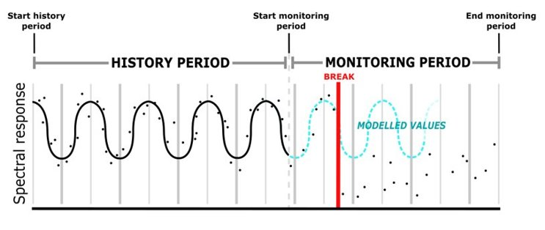
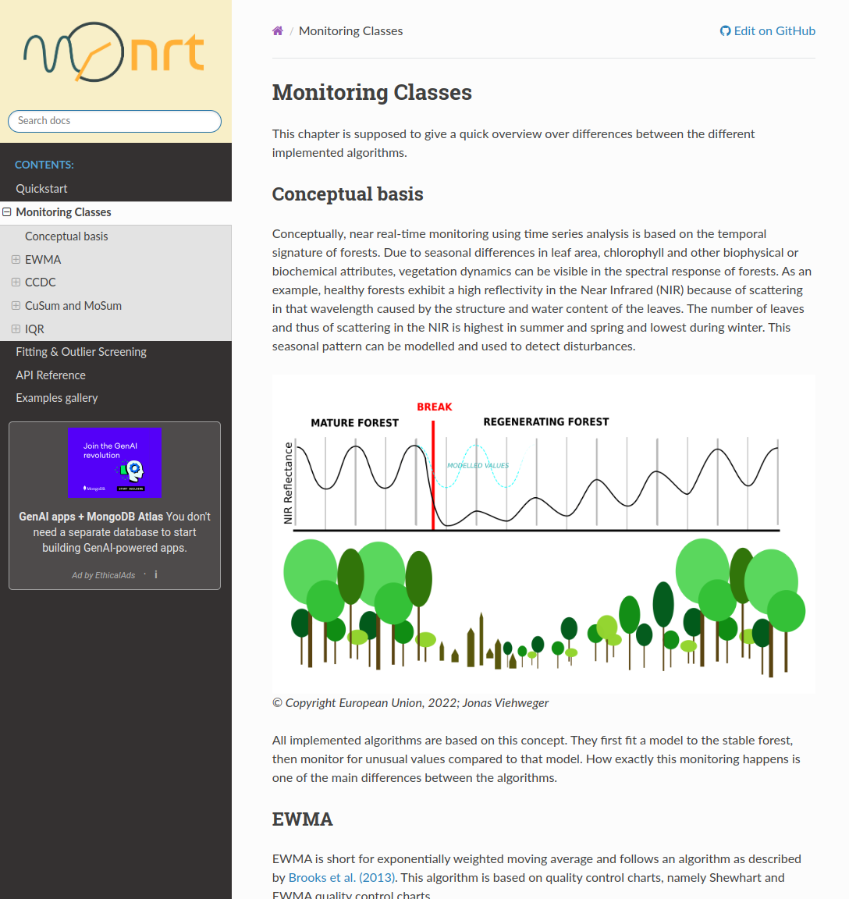
nrt package, core concept
Python package, open source https://github.com/ec-jrc/nrt (first release in March 2022)
Designed for continuous monitoring of satellite image time series
Standardized interface to multiple online monitoring algorithms (MoSum, CuSum, EWMA, IQR, CCDC)
Optimized for fast computation and scalability
Suitable for operational deployment (monitoring states can be saved to disk)

Slide 3
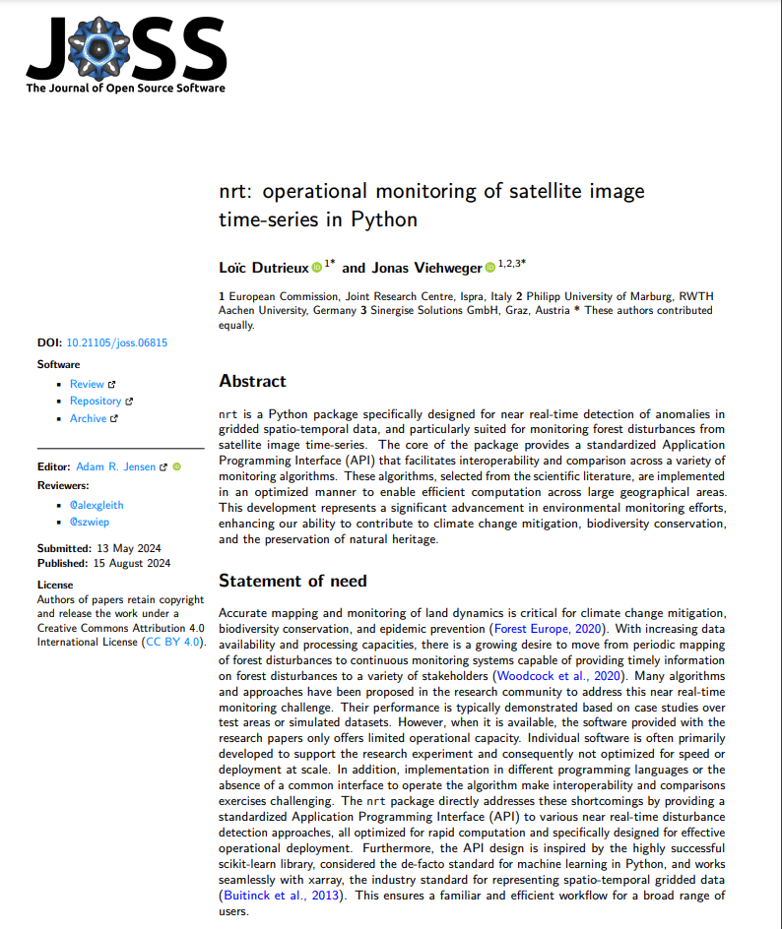
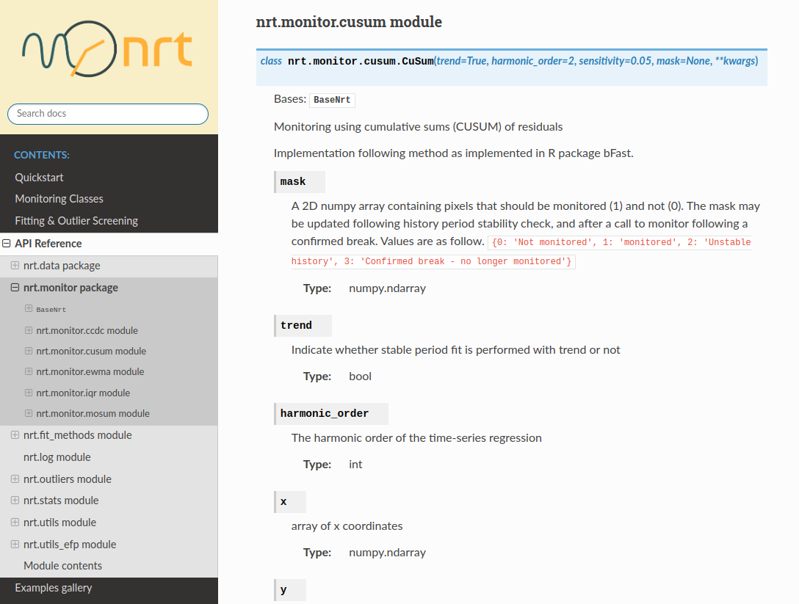
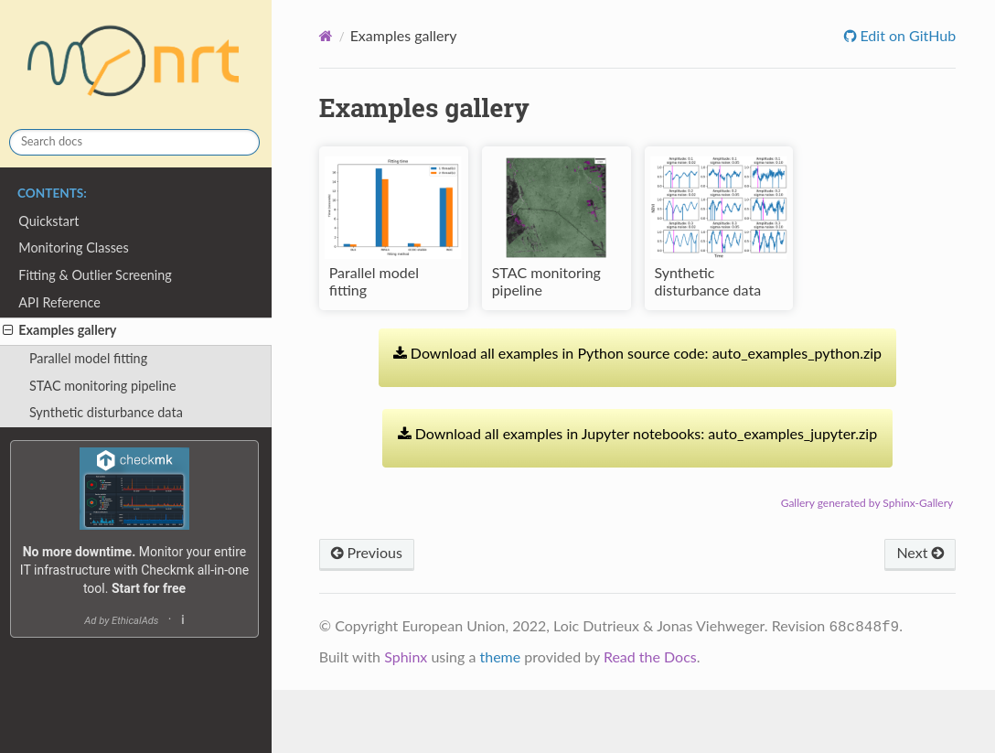
Online documentation with tutorials and examples
Online documentation: https://nrt.readthedocs.io/en/latest/index.html
JOSS paper: https://joss.theoj.org/papers/10.21105/joss.06815

Slide 4
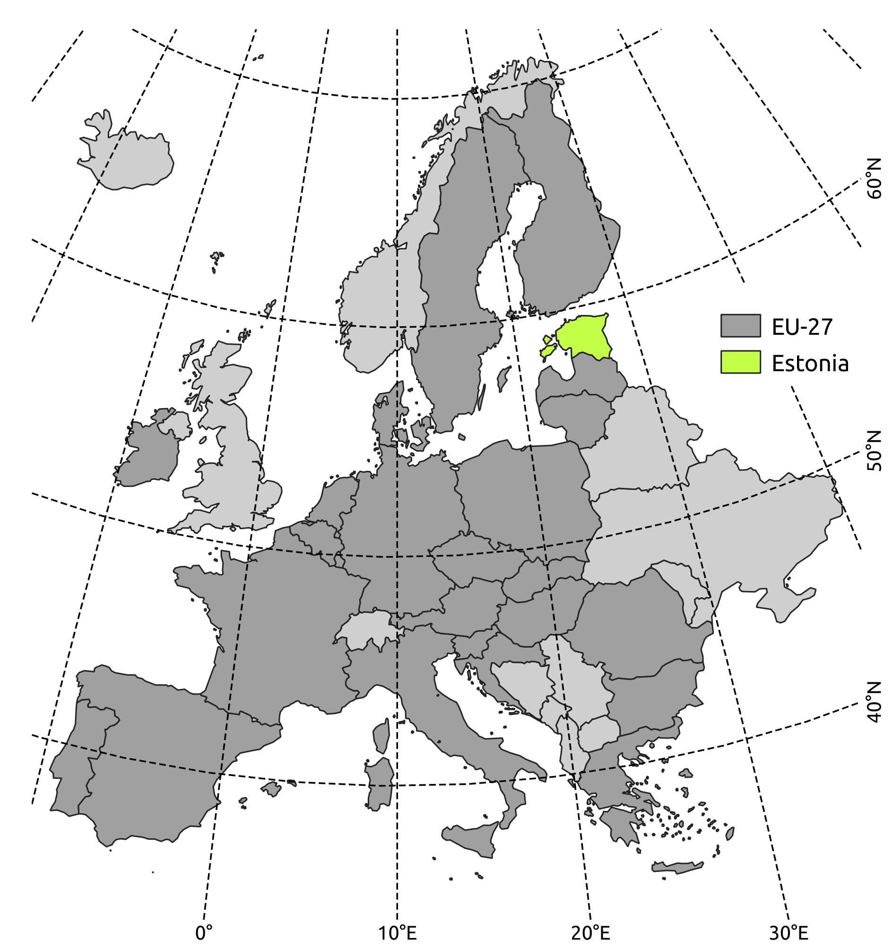
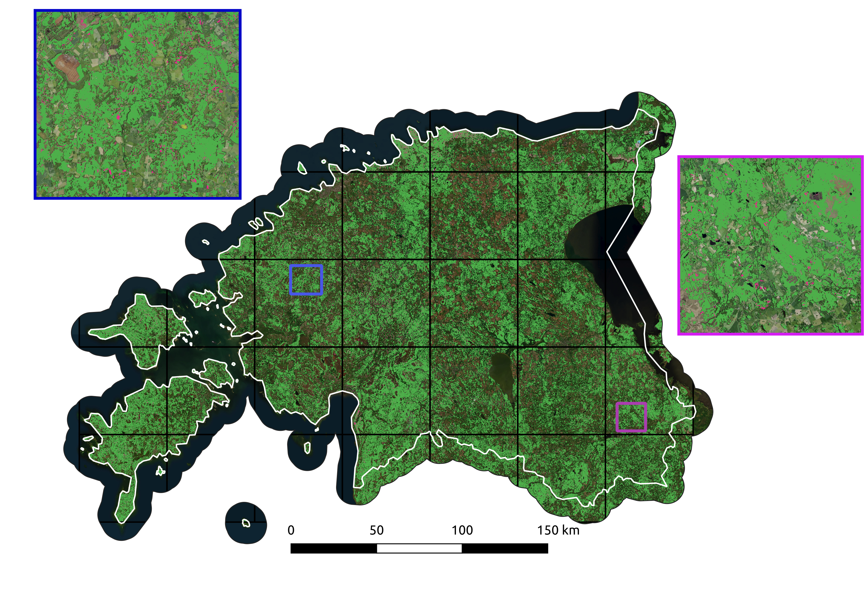
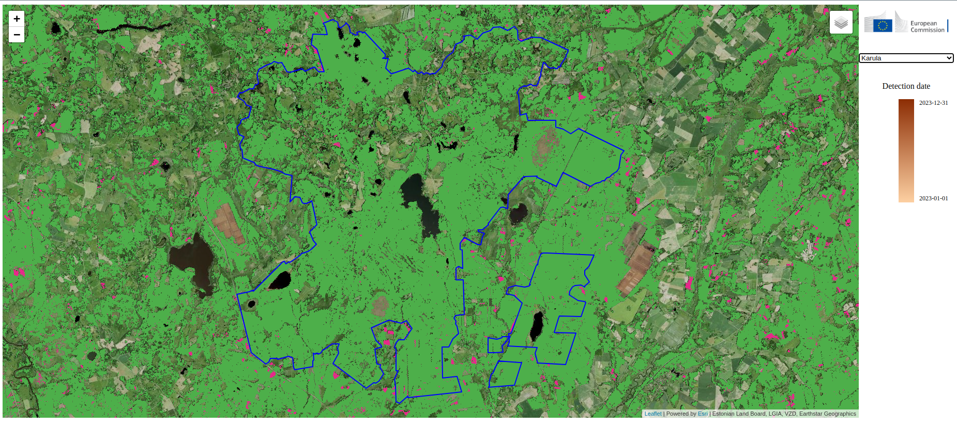

Example of operational deployment at scale
Operational forest disturbances alert prototype
Covers the entire territory of Estonia
Updated daily
Runs on JRC's Big Data Analytics Platform (BDAP)

Slide 5


The nrt "ecosystem"
Utilities for cal/val
Temporal accuracy metrics
Interface for visual interpretation
Formerly part of nrt core
Easy access to test and demonstration data
Core package with implementation of monitoring algorithms
nrt-diagnostic?
nrt-ensemble?

Slide 6
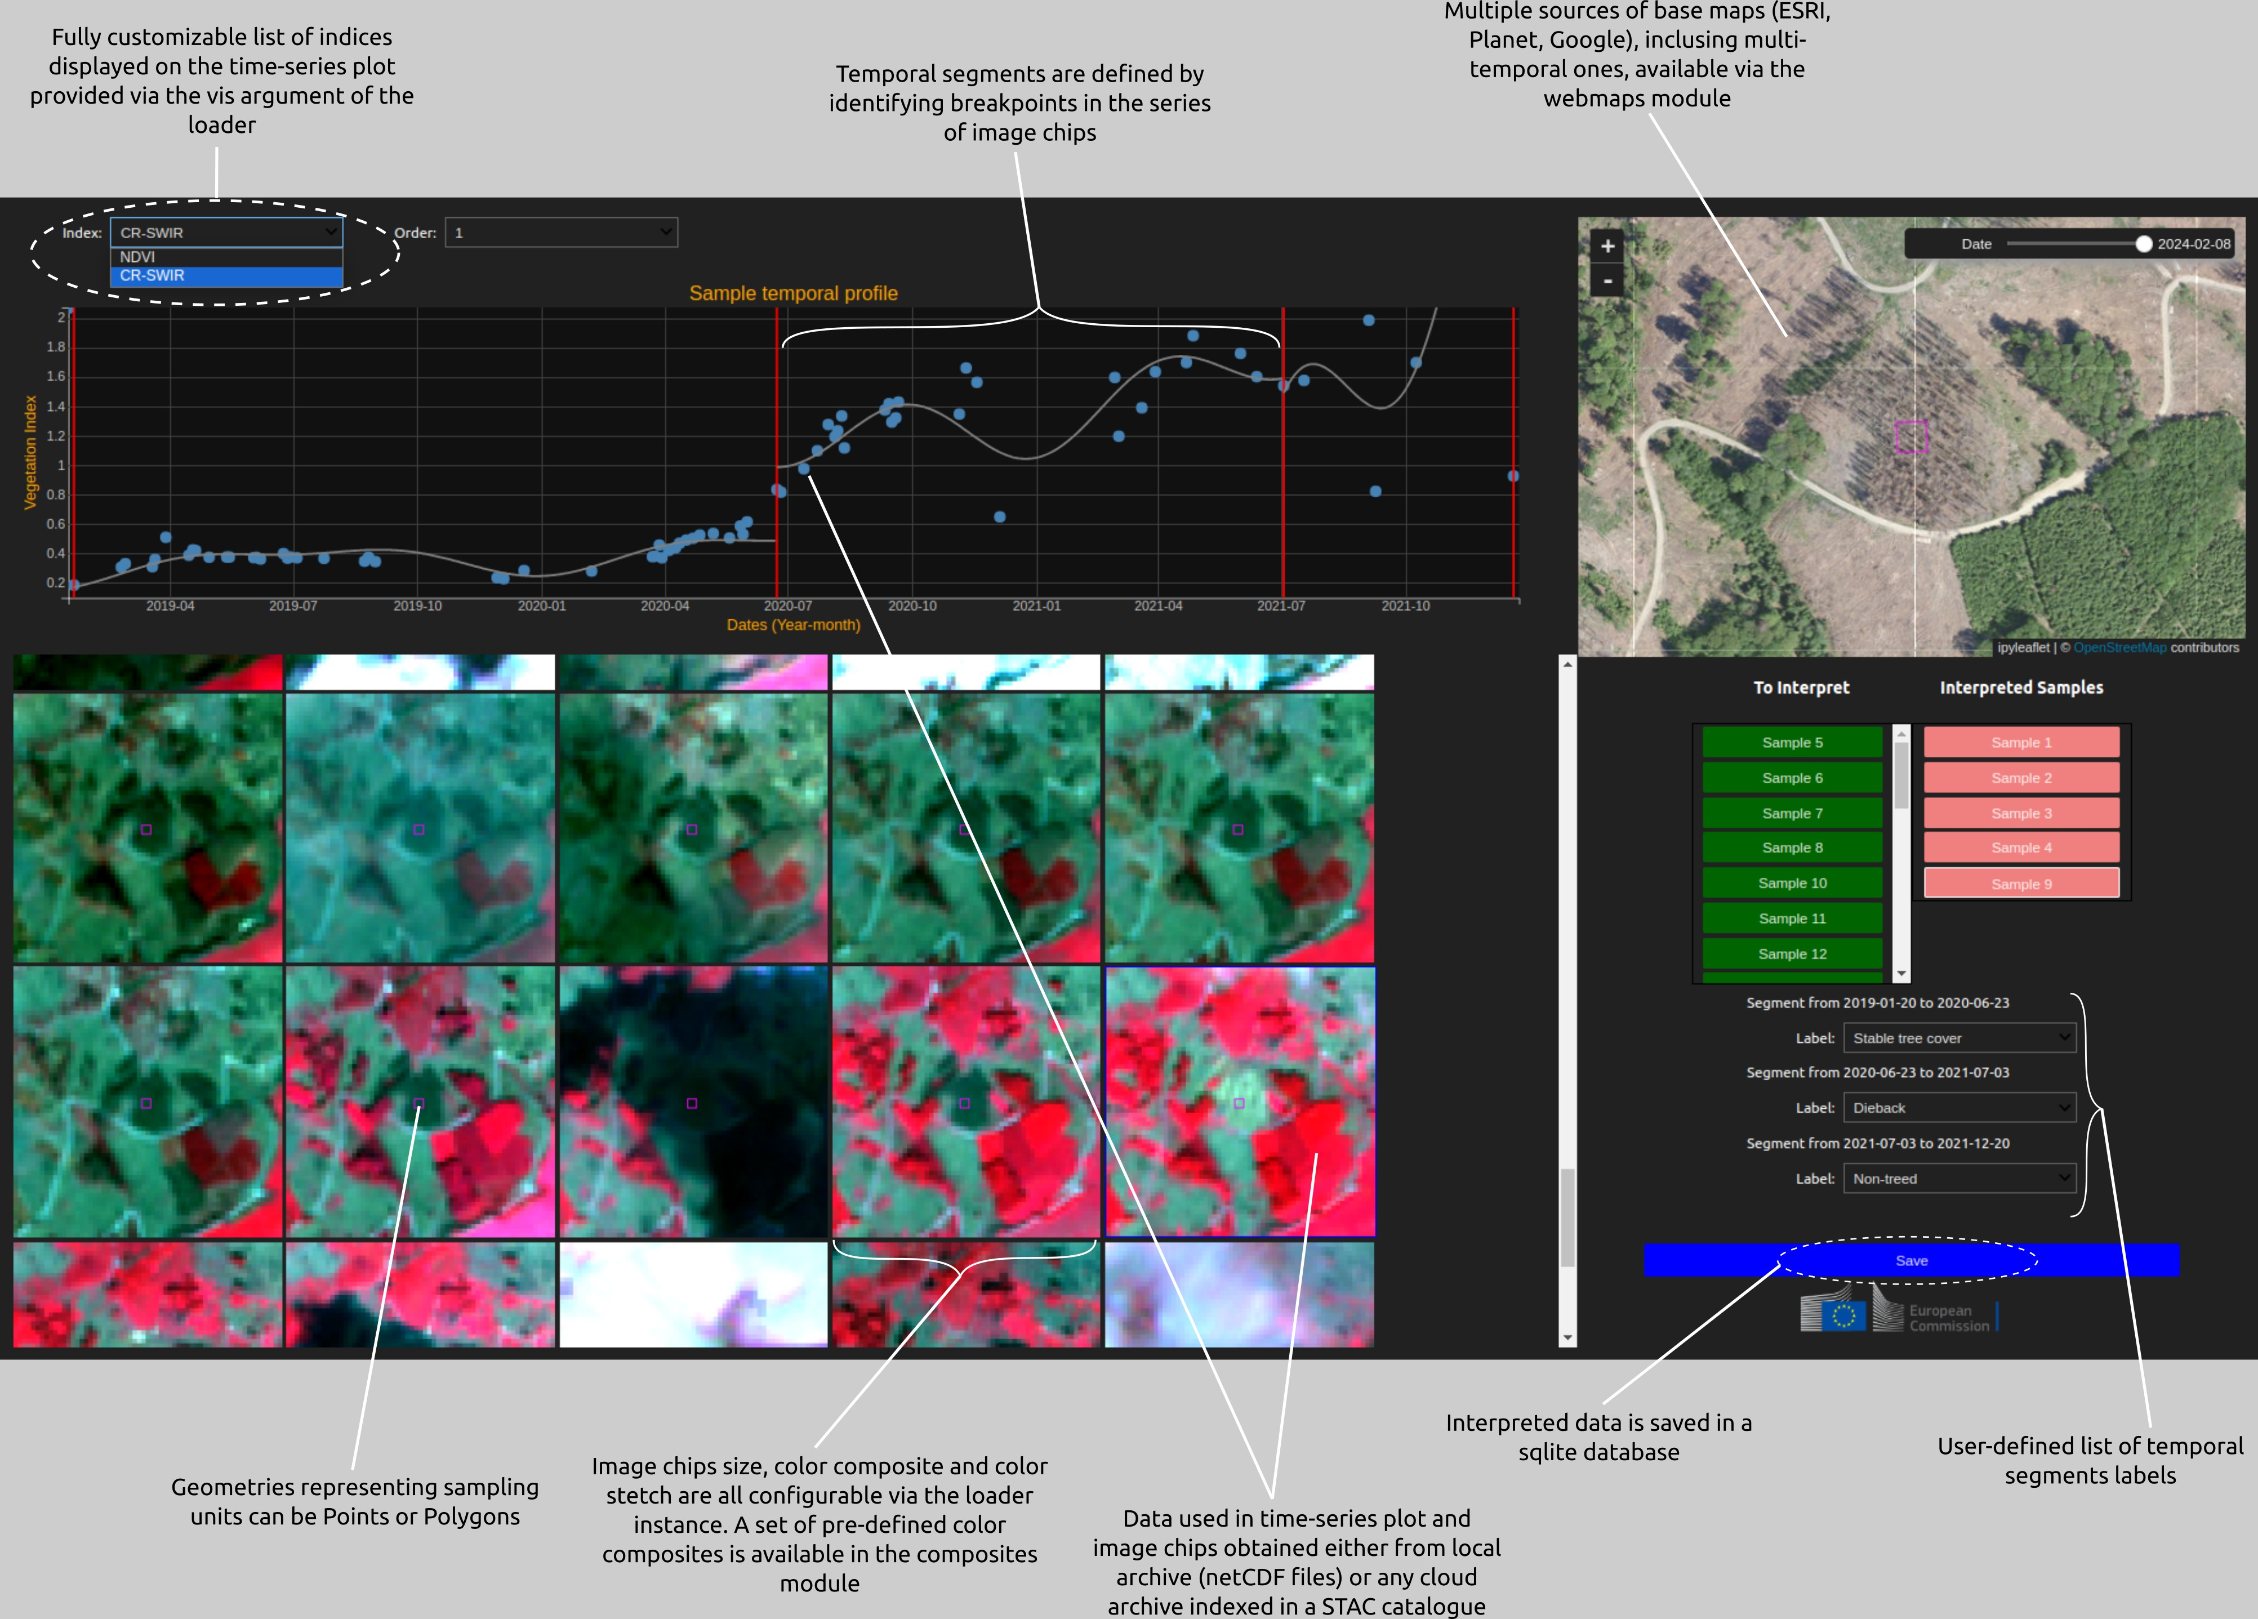
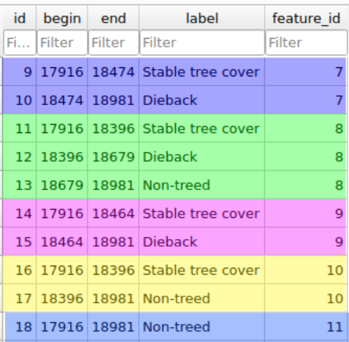
nrt-validate's temporal segment labelling interface
Fully customizable
Online demo here
Easy to deploy locally from a notebook using a voila command (recommended)

Slide 7
Demo time !!!
https://github.com/loicdtx/OEMC2024_nrt-workshop/blob/master/notebooks/nrt_forest_monitoring.ipynb

Slide 8
Thank you
This presentation has been prepared for internal purposes. The information and views expressed in it do not necessarily reflect an official position of the European Commission or of the European Union.
Except otherwise noted, © European Union (year). All Rights Reserved
Slide xx: element concerned, source: e.g. Fotolia.com; Slide xx: element concerned, source: e.g. iStock.com

